Slide 1

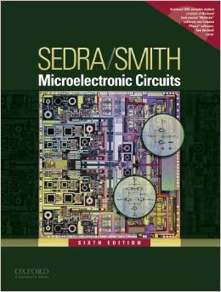
International University
School of Electrical Engineering
ANALOG ELECTRONICS
Lecture # 8: Signal generators and waveform-shaping circuits
Text book:
Sedra and Smith, “Microelectronic Circuits,” 6th Edition.
Link: Blackboard to download materials

Slide 2
Signal generators and waveform-shaping circuits
Introduction
17.1 Basic principles of sinusoidal oscillators
17.2 RC oscillator circuits
17.3 LC and crystal oscillators
17.4 Bistable Multivibrators
17.5 Generation of a standardized pulse-The
monostable multivibrator

Slide 3
Introduction
There are two different approaches for the generation of sinusoids, most commonly used for the standard waveforms:
Employing a positive-feedback loop that consists an amplifier and an RC or LC frequency-selective network. It generates sine waves utilizing resonance phenomena, are known as linear oscillators (Section 17.1-3)
Circuits that generate square, triangular, pulse waveforms are called non-linear oscillators or function generators
The bistable multivibrator(Section 17.4)
the astable multivibrator (Section 17.5)
the monostable multivibrator(Section 17.6)
A sine wave is obtained by appropriate shaping a triangular waveform

Slide 4
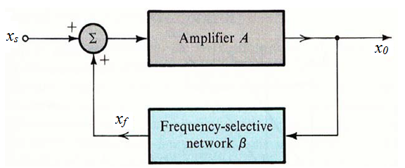
The basic structure of sinusoidal oscillators
A positive-feedback loop is formed by an amplifier and frequency-selective network
Amplifier circuit: realize the energy control
Frequency-selective network : oscillator frequency is determined
Positive feedback loop :
amplitude control : implementation of the nonlinear amplitude-stabilization mechanism
The basic
structure

Slide 5
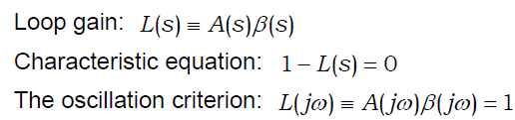
The basic structure of sinusoidal oscillators
Feedback signal x_{f} is summed with a positive sign
The gain-with-feedback (Transfer function) is
➔ At ω0 the phase of the loop gain should be zero and the magnitude of the loop gain should be unity. (Barkhausen criterion)
For the circuit to produce sustained oscillations at a frequency ω0 the characteristic equation has to have roots at s = ± ω0.
❑ Barkhausen criterion:
The phase of loop gain should be zero at ω₀ .
The magnitude of the loop gain should be unity at ω₀ .
The characteristic equation has roots at s = ± jω₀ .

Slide 6
Oscillator
Linear region of the circuit: linear oscillation
Nonlinear region of the circuit: amplitude stabilization

Slide 7
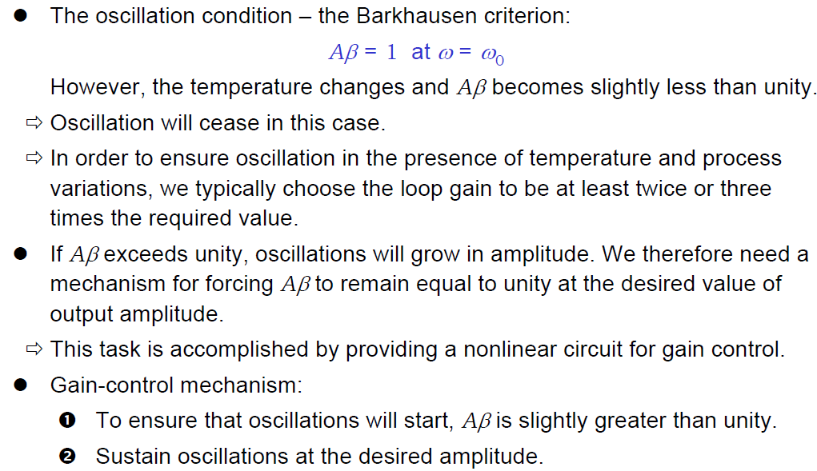
Nonlinear Amplitude Control

Slide 8
The implementation of the nonlinear amplitude-stabilization mechanism
The first approach makes use of a limiter circuit
The other mechanism for amplitude control utilizes an element whose resistance can be controlled by the amplitude of the output sinusoid.

Slide 9
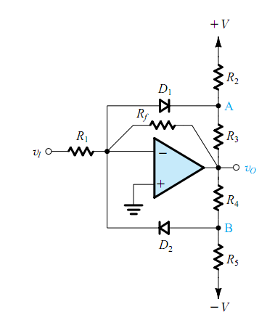
A Popular Limiter Circuit for Amplitude Control
Linear portion: (linear region)
When v_{i} is close to zero:
Figure 17.3 (a) A popular limiter circuit.
Notes:
consider first the case of a small (close to zero) input signal v_{I} and a small output voltage v_{O}, so that v_{A} is positive and v_{B} is negative.

Slide 10
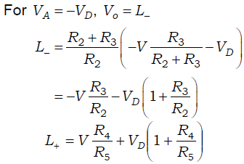
A Popular Limiter Circuit for Amplitude Control
When v_{i} goes positive,D₁ is on, D₂ is off
the negative limiting level
the positive limiting level
Figure 17.3 (a) A popular limiter circuit.

Slide 11
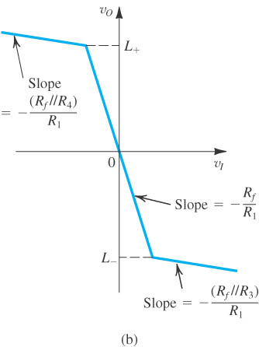
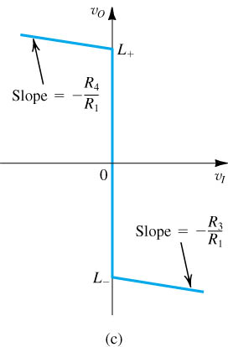
A Popular Limiter Circuit for Amplitude Control
Figure 17.3
Figure 17.3
Fig. 17.3 (b) Transfer characteristic of the limiter circuit;
When R_{f} is removed, the limiter turns into a comparator with the characteristic shown Figure 17.3 (c).

Slide 12
Oscillator Circuits
Op Amp-RC Oscillator Circuits
The Wien-Bridge Oscillator
The phase-Shift Oscillator
LC-Tuned Oscillator
Colpitts oscillator
Hareley oscillator
Crystal Oscillator

Slide 13
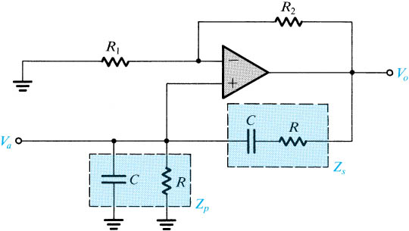
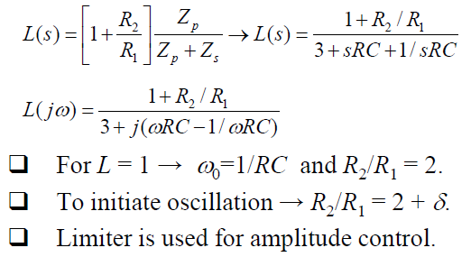
The Wien-Bridge Oscillator
Fig. 17.4: A Wien-bridge oscillator without amplitude stabilization.

Slide 14
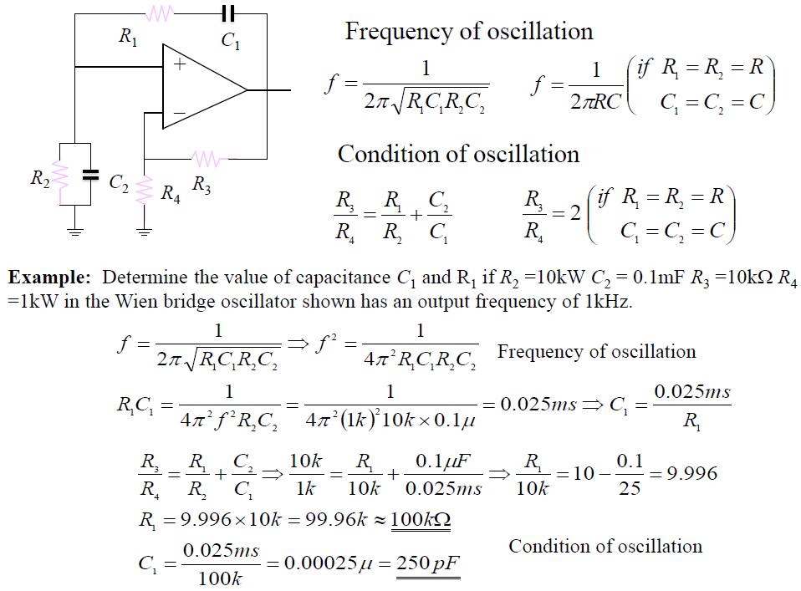
Example: The Wien-Bridge Oscillator
Example: Determine C₁ and R₁ if R₂ = 10k, C₂ = 0.1µF, R₃ = 10k, R₄ = 1k in the Wien bridge oscillator shown has an output frequency of 1kHz.

Slide 15
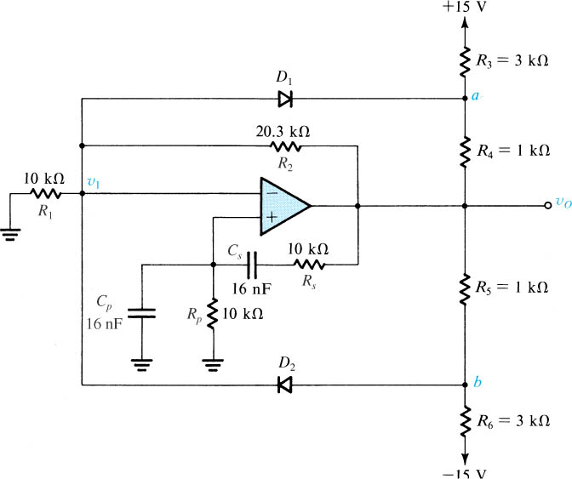
The Wien-Bridge Oscillator
Fig. 17.5: A Wien-bridge oscillator with a limiter used for amplitude control.

Slide 16
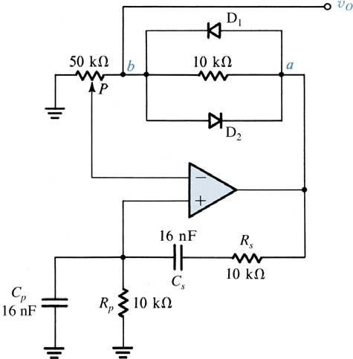
Fig. 17. 6: Wien-bridge oscillator with an alternative method for amplitude stabilization

Slide 17
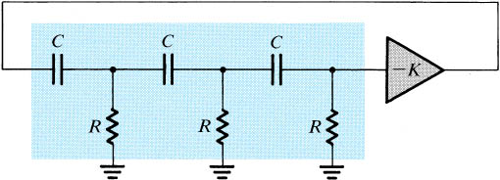
The Phase-Shift Oscillator
The basic structure of the phase-shift oscillator
It consists of a negative-gain amplifier (−K ) with a three-section (third-order) RC ladder network in the feedback.
The circuit oscillates at the frequency for which the phase shift of the RC network is 180°.
Only at this frequency will the total phase shift around the loop be 0 or 360°.

Slide 18
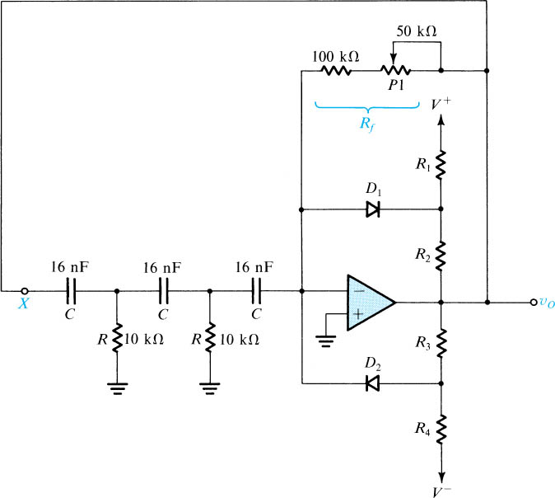
The Phase-Shift Oscillator
To start oscillations, R_{f} has to be made slightly greater
than the minimum required value. Although the circuit
stabilizes more rapidly, and provides sine waves with
more stable amplitude, if R_{f} is made much larger than this
minimum, the price paid is an increased output distortion.
Fig. 17.8: A practical phase-shift oscillator with a limiter for amplitude stabilization.

Slide 19
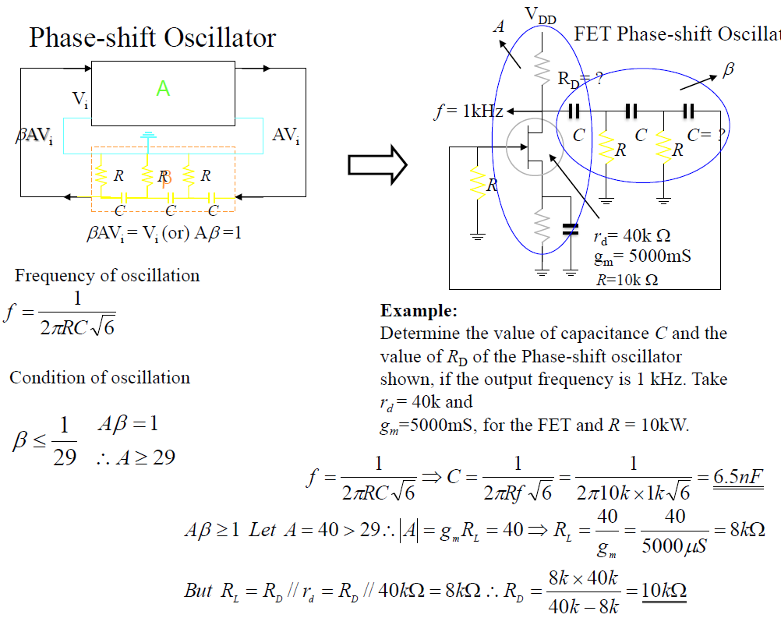
The Phase-Shift Oscillator
R = 1k

Slide 20
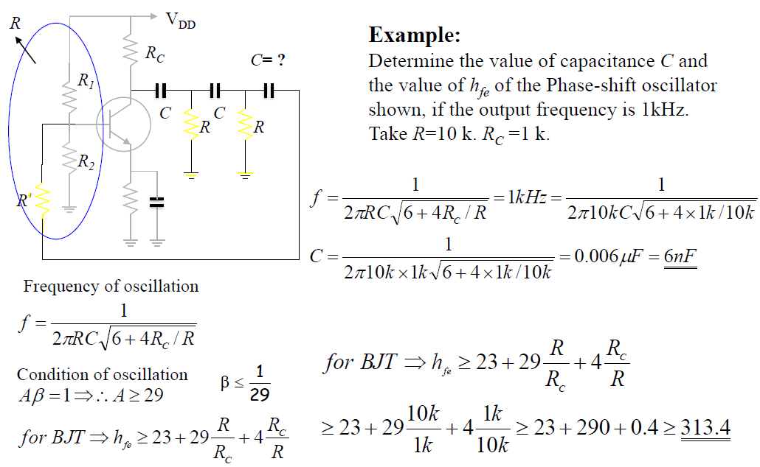
The Phase-Shift Oscillator
BJT Phase-Shift Oscillator

Slide 21
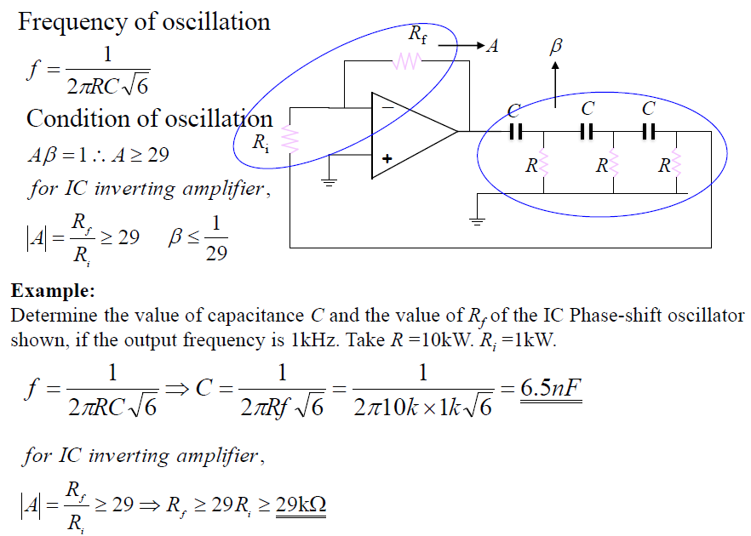
The Phase-Shift Oscillator
R = 10k, R_{i} = 1k

Slide 22

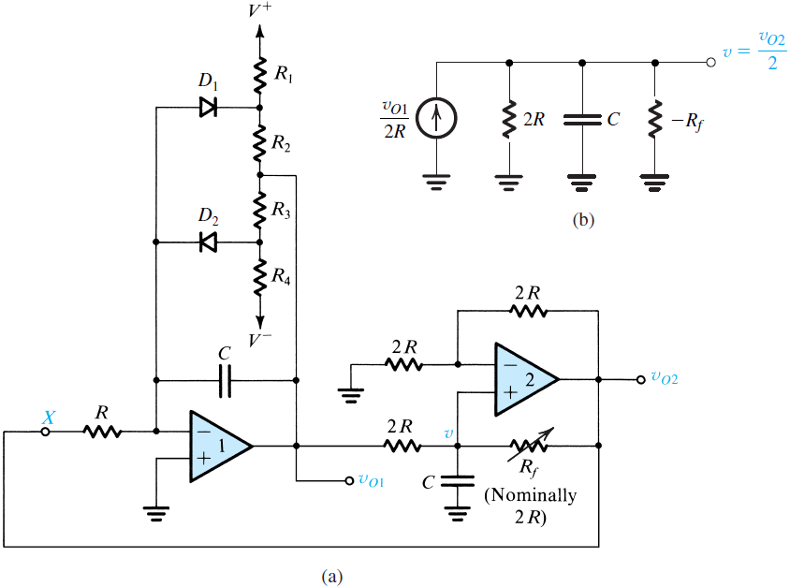
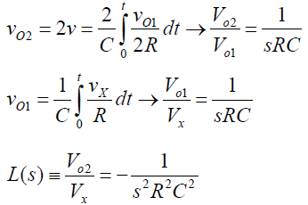

Quadrature Oscillator
v=v_{o2}/2
v_{o2}
Decreasing R_{f} to ensure that oscillation starts
Too much positive feedback results in higher output distortion
v
v_{o1}
Figure 17.9 (a) A quadrature-oscillator circuit. (b) Equivalent circuit at the input of op amp 2.

Slide 23
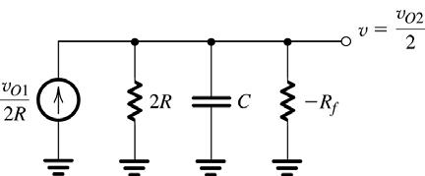
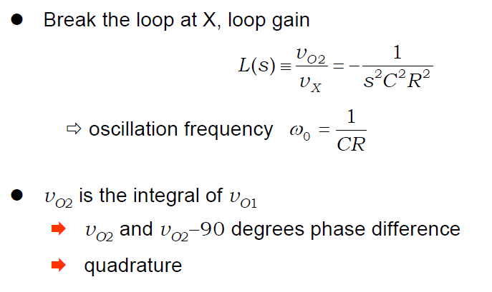
Quadrature Oscillator
The name quadrature oscillator is used because the circuit provides two sinusoids with 90° phase difference.

Slide 24
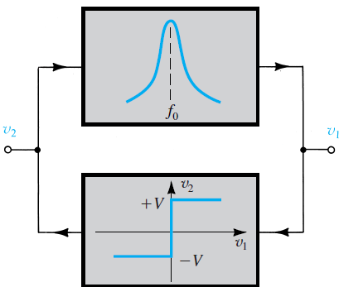


Active-Filter Tuned Oscillator
Assume the oscillations have already started. The output of the band-pass filter will be a sine wave whose frequency is equal to the center frequency of the filter.
The sine-wave signal is fed to the limiter and then produces a square wave.
❑ The circuit consists of a high-Q bandpass filter connected in a positive-feedback loop with a hard limiter.
❑ Any filter circuit with positive gain can be used to implement the bandpass filter.
❑ Can generate high-quality output sine waves.
❑ Have independent control of frequency, amplitude and distortion of the output sinusoid.
Figure 17.10 Block diagram of the active-filter-tuned oscillator.
Op amp-RF oscillators ~ 10 to 100kHz.

Slide 25
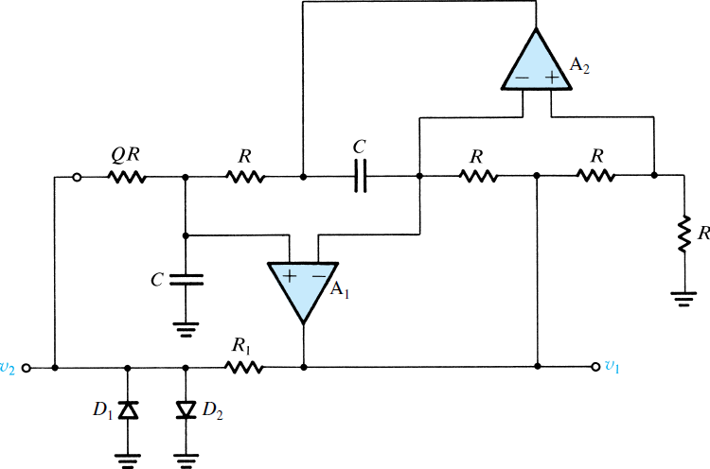
Active-Filter Tuned Oscillator
Fig. 17.11 A practical implementation of the active-filter tuned oscillator

Slide 26
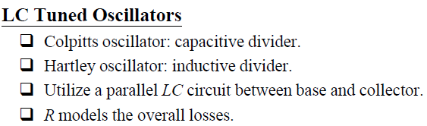
LC AND CRYSTAL OSCILLATORS

Slide 27
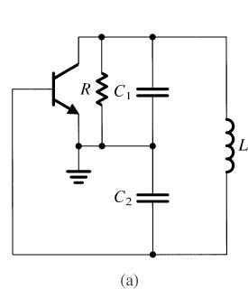
The LC-Tuned oscillator
For higher frequencies (> 1MHz)
Colpitts Oscillator
A parallel LC resonator connected between collector and base.
Feedback is achieved by way of a capacitive divider
Oscillating frequency is determined by the resonance frequency.
(capacitive divider feedback)

Slide 28
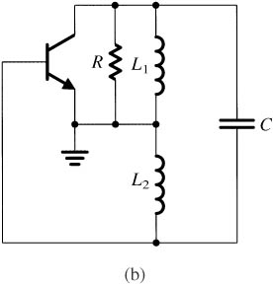

The LC-Tuned oscillator
For higher frequencies (> 1MHz)
Hartley Oscillator
A parallel LC resonator connected between collector and base.
Feedback is achieved by way of an inductive divider.
Oscillating frequency is determined by the resonance frequency.
(inductive divider feedback)

Slide 29
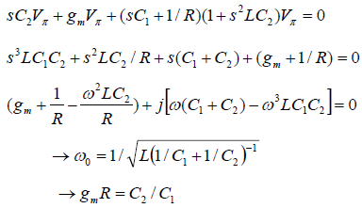
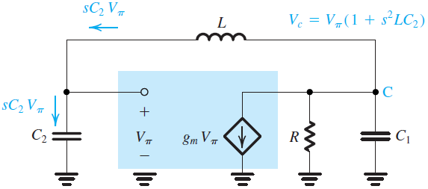
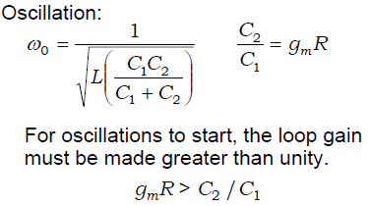
The LC-Tuned oscillator
Analysis of Equivalent circuit of the Colpitts oscillator
❑ LC-tuned oscillators utilize the nonlinear transistor I-V characteristics for amplitude control (self-limiting).
❑ Collector (drain) current waveforms are distorted due to the nonlinear characteristics.
❑ Output voltage is a sinusoid with high purity because of the filtering action of the LC tuned circuit.

Slide 30
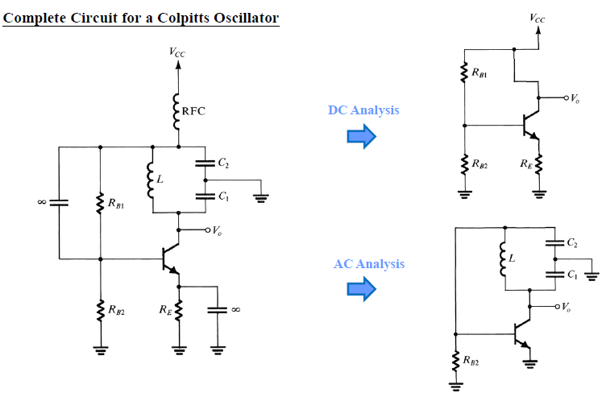

Slide 31
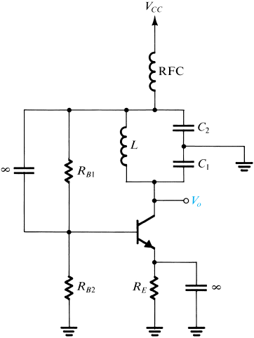
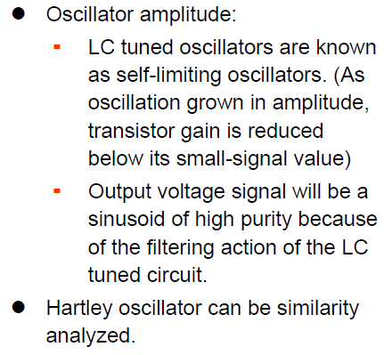
The LC-Tuned oscillator
Radio frequency choke (RFC)
Fig. 17.14 Complete circuit for a Colpitts oscillator

Slide 32
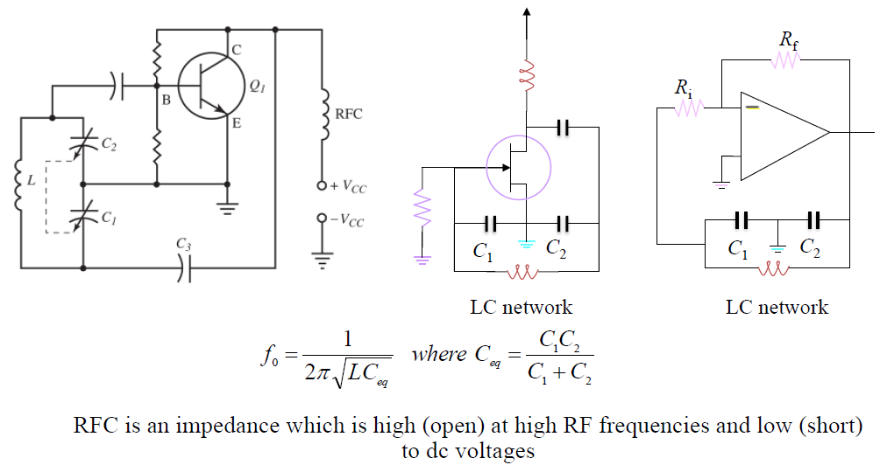
The LC-Tuned oscillator
Colpitts Oscillators: BJT; FET; and IC Based

Slide 33
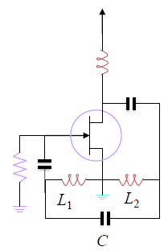
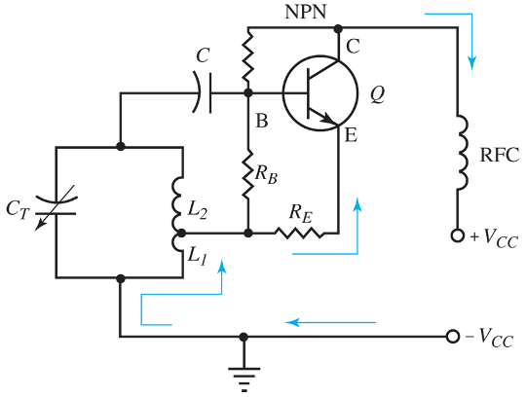
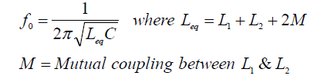
The LC-Tuned oscillator
Hartley Oscillator: Used in radio receivers and transmitters More stable than Armstrong oscillators Radio frequency choke (RFC)

Slide 34
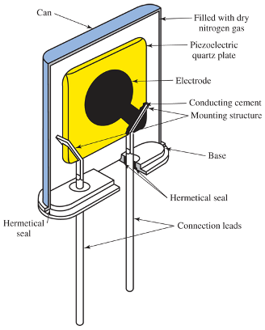
Crystal Oscillators
Crystal is a piezo-electric device which converts mechanical pressure to electrical voltage or vice-versa
Radio communications, broadcasting stations
Piezoelectric effect
Why are crystal oscillators used in many commercial transmitters?

Slide 35
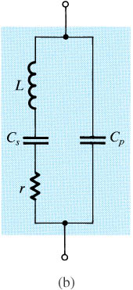
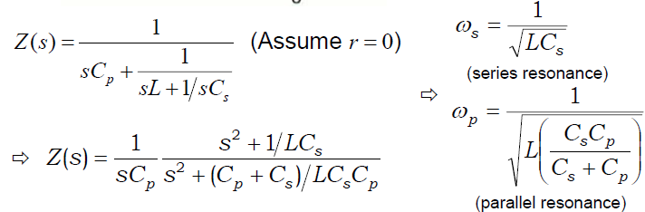
LC-tuned oscillators –Crystal Oscillators
Piezoelectric crystal (is high-Q device)
Fig. 17.15 A piezoelectric crystal. (a) Circuit symbol. (b) Equivalent circuit. (c) Crystal reactance versus frequency [note that, neglecting the small resistance r, Z_{crystal} = jX(ω)].

Slide 36
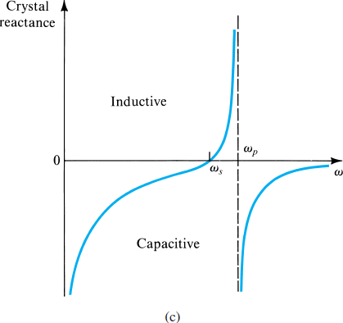

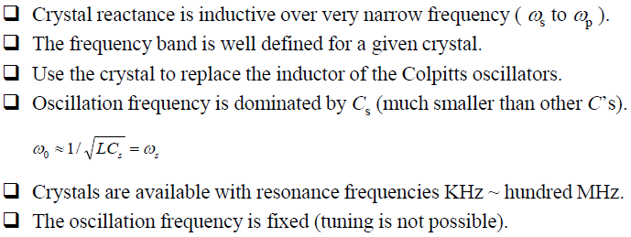
LC-tuned oscillators –Crystal Oscillators

Slide 37
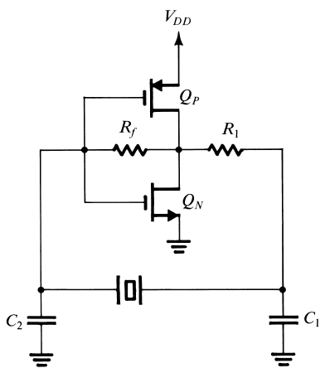
LC-tuned oscillators –Crystal Oscillators
A Colpotts (or Pierce) crystal oscillator utilizing a CMOS inverter as an amplifier

Slide 38
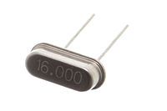
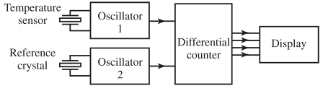
An Application of Crystal Oscillator
Crystals are fabricated by cutting the crude quartz in a very exacting fashion. The type of cut determines the crystal’s natural resonant frequency as well as it’s temperature coefficient.
Crystal are available at frequencies about 15kHz and up providing the best frequency stability. However above 100MHz, they become so small that handling becomes a problem.
A miniature 16 MHz quartz crystal enclosed in a hermetically sealed HC-49/S package, used as the resonator in a crystal oscillator.
Two crystals producing two different frequencies for measuring temperature Timing devices

Slide 39
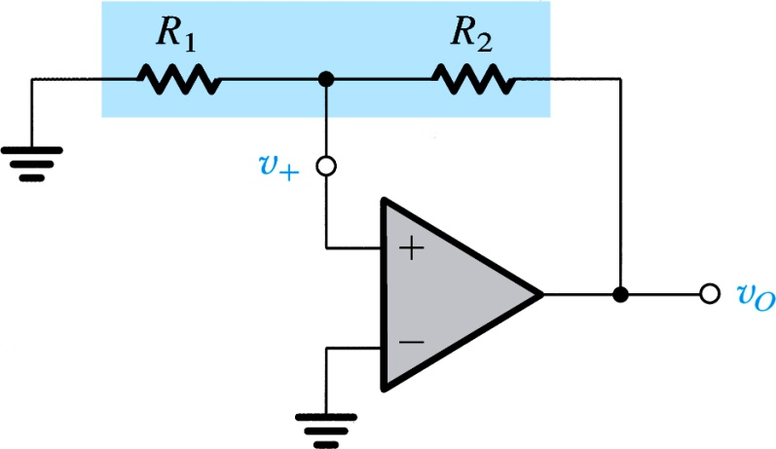
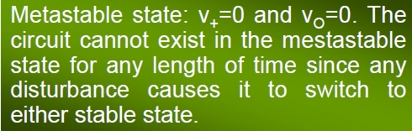
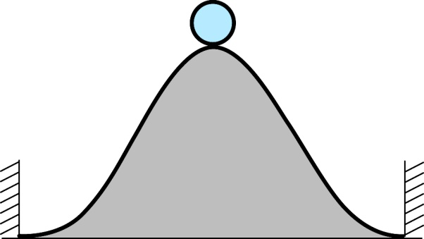

Bistable Multivibrators
Another type of waveform generating circuits is the nonlinear oscillators or function generators which uses multivibrators.
A bistable multivibrator has 2 stable states. The circuit can remain in either state indefinitely and changes to the other one only when triggered.
Figure 17.17 A positive-feedback loop capable of bistable operation.
Figure 17.18 A physical analogy for the operation of the bistable circuit. The ball cannot remain at the top of the hill for any length of time (a state of unstable equilibrium or metastability); the inevitably present disturbance will cause the ball to fall to one side or the other, where it can remain indefinitely (the two stable states).

Slide 40
Bistable Circuit -- three basic factors
The output signal only has two states: positive saturation(L₊) and negative saturation(L₋).
The circuit can remain in either state indefinitely and move to the other state only when appropriate triggered.(threshold voltage)
The direction of one stage moving to the other stage.
A positive feedback loop capable of bistable operation.

Slide 41
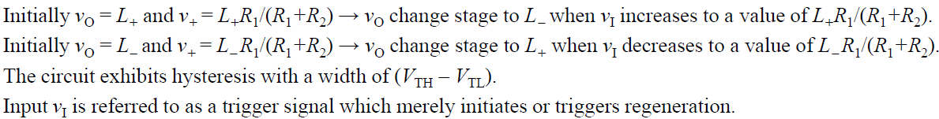
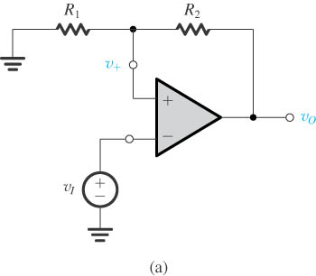
Bistable Circuit
Transfer Characteristics of the Inverting Bistable Circuit
The bistable circuit (positive feedback loop)
The negative input terminal of the op amp connected to an input signal v_{I}.
Figure 17.19 (a) The bistable circuit of Fig. 17.17 with the negative input terminal of the op amp disconnected from ground and connected to an input signal v_{I}.

Slide 42



Bistable Circuit
Transfer Characteristics of the Inverting Bistable Circuit
Trigger signal
The transfer characteristic of the circuit in (a) for increasing v_{I}.
Positive saturation L₊ and negative saturation L₋
The transfer characteristic for decreasing v_{I}.
The complete transfer characteristics.
Figure 17.19 (b) The transfer characteristic of the circuit in (a) for increasing v_{I}. (c) The transfer characteristic for decreasing v_{I}.

Slide 43



A Bistable Circuit with Noninverting Transfer Characteristics
Figure 17.20 A bistable circuit derived from the positive-feedback loop of Fig. 17.17 by applying v_{I} through R₁.
The transfer characteristic is noninverting.

Slide 44
Application of Bistable Circuit as a Comparator
Comparator is an analog-circuit building block used in a variety applications.
To detect the level of an input signal relative to a preset threshold value.
To design A/D converter.
Include single threshold value and two threshold values.
Hysteresis comparator can reject the interference.

Slide 45


Application of Bistable Circuit as a Comparator
Figure 17.21 (a) Block diagram representation and transfer characteristic for a comparator having a reference, or threshold, voltage V_{R}. (b) Comparator characteristic with hysteresis.

Slide 46

Application of Bistable Circuit as a Comparator
To design a circuit that detects and counts the zero crossings of an arbitrary waveform, a comparator whose threshold is set to 0 can be used. The comparator provides a step change at its output every time zero crossing occurs.
Illustrating the use of hysteresis in the comparator characteristics as a means of rejecting interference.

Slide 47


Bistable Circuit with More Precise Output Level
Fig. 17.23: Limiter circuits are used to obtain more precise output levels for the bistable circuit.
For this circuit L₊ = V_{Z1} + V_{D} and L– = –(V_{Z2} + V_{D}), where V_{D} is the forward diode drop.
For this circuit L₊ = V_{Z} + V_{D1} + V_{D2} and L– = –(V_{Z} + V_{D3} + V_{D4}).

Slide 48


Generation of Square Waveforms
Operation of the Astable Multivibrator
Fig. 17. 24: (a) Connecting a bistable multivibrator with inverting transfer characteristics in a feedback loop with an RC circuit results in a square-wave generator. (b) The circuit obtained when the bistable multivibrator is implemented with the positive feedback loop circuit.

Slide 49


Generation of Square Waveforms
Fig. 17. 24: (b) The circuit obtained when the bistable multivibrator is implemented with the positive feedback loop circuit.

Slide 50

Fig. 17. 24: (c) Waveforms at various nodes of the circuit in (b).
This circuit is called an astable multivibrator.
Time period T = T₁+T₂

Slide 51



Generation of Triangle Waveforms
Triangular waveforms can be obtained by replacing the low-pass RC circuit with an integrator. Since the integrator is inverting, the inverting characteristics of the bistable circuit is required.
Fig. 17. 25: A general scheme for generating triangular & square waveforms

Slide 52

Exercise 17.2
For the circuit of Fig. 17.3(a) with V = 15 V, R₁ = 30 kΩ, R_{f} = 60 kΩ, R₂ = R₅ = 9 kΩ, and R₃ = R₄ = 3 kΩ, find the limiting levels and the value of v_{I} at which the limiting levels are reached. Also determine the limiter gain and the slope of the transfer characteristic in the positive and negative limiting regions. Assume that V_{D} = 0.7 V.
Figure 17.3 (a) A popular limiter circuit.

Slide 53




Exercise 17.2 – Sol.
We have:
=
=
Limiter gain = - R_{f} / R₁ = - 60 / 30 = - 2 V/V
Slope in the limiting regions:

Slide 54

Exercise 17.3
For the circuit in Fig. 17.5: (a) Disregarding the limiter circuit, find the location of the closed-loop poles. (b) Find the frequency of oscillation. (c) With the limiter in place, find the amplitude of the output sine wave (assume that the diode drop is 0.7 V).
Figure 17.5 A Wien-bridge oscillator with a limiter used for amplitude control.

Slide 55




Exercise 17.3 – Sol.
The loop gain
=
=
With R = 10kΩ & C = 16 nF
The closed loop poles are found by setting L(s) =1, that is, they are the values of s,

Slide 56
Exercise 17.3 – Sol.
(b) The frequency of oscillation is 10⁵/16 rad/s or 1 kHz
(c) Refer to Fig., at the positive peak Vo, the voltage at node b will be one diode drop (0.7V) above the voltage Vi which is about 1/3 of Vo.
Thus Vb = 0.7 + Vo/3.
Now, if we neglect the current through D2 in comparison with the currents through R5 & R6 we find that:
3
From symmetry, we see that the negative peak is equal to the positive peak. Thus the output peak-to-peak voltage is 21.36 V

